Slide 1
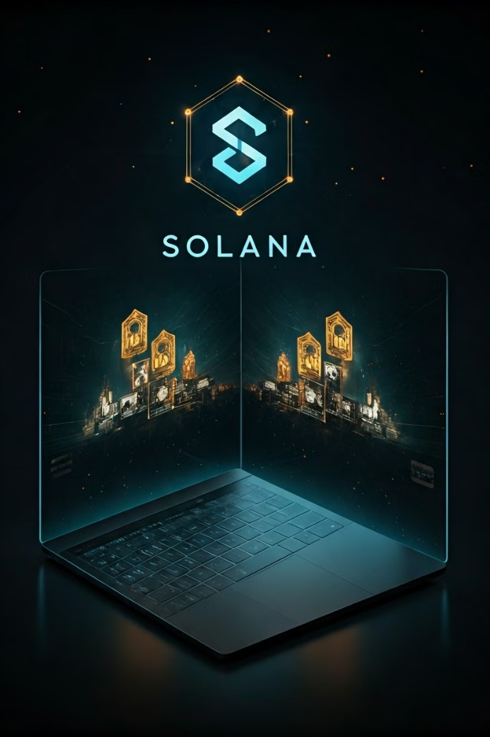

Solana Publish: Decentralized Publishing for Creators
Empowering creators with blockchain and NFTs. A revolutionary platform that addresses traditional publishing challenges and social issues. Presented by Momoko Amemiya at the Rader Hackathon on 2024/10/5.
by Momoko Amemiya

Slide 2

The Problem with Traditional Publishing
1
High Costs
Intermediaries take a significant portion of creators' profits.
2
Limited Ownership
Creators lose control over distribution and royalties.
3
Slow Process
Publishing involves many gatekeepers, making it time-consuming.
4
Inefficient Fan Support
Limited opportunities for fans to directly support creators.

Slide 3
Addressing an Important Social Issue
Limited Audience
Marginalized Voices
Decentralized Solution
Meaningful content struggles to gain traction against mainstream trends.
Important topics and influential authors often go unnoticed due to market trends.
Solana Publish provides a direct path to audience using NFTs.

Slide 4





Solana Publish: Decentralized Publishing
Direct-to-Consumer
Creators publish and sell directly to fans, removing intermediaries.
NFT Ownership
Work is turned into NFTs, ensuring digital ownership and authenticity.
Fast Transactions
Solana's blockchain enables fast, low-cost transactions for all users.
Automatic Royalties
Smart contracts ensure creators receive royalties on every resale.

Slide 5

The Solana Publish Ecosystem
1
Upload Content
Creators publish their work and turn it into an NFT.
2
NFT Marketplace
Users buy, sell, and trade digital content as NFTs.
3
Automatic Royalties
Creators receive a percentage of each resale automatically.
4
Fan Support
Fans can directly support creators by buying work or donating.

Slide 6
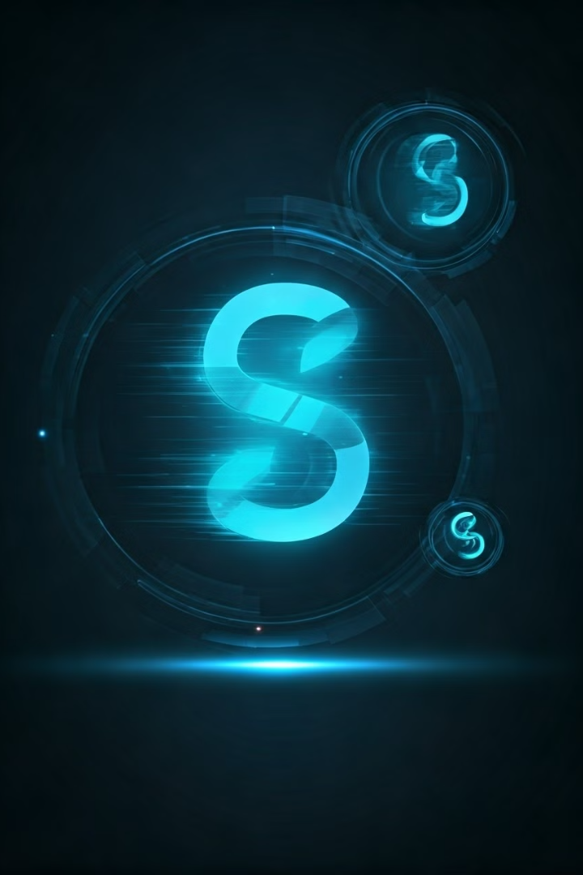
Why Use Solana for Publishing?
Fast Transactions
Solana processes up to 65,000 transactions per second.
Low Fees
Average transaction fee is a fraction of a cent.
Scalability
Designed to handle massive amounts of data and transactions.
Security
Blockchain ensures transparency and security in every transaction.

Slide 7
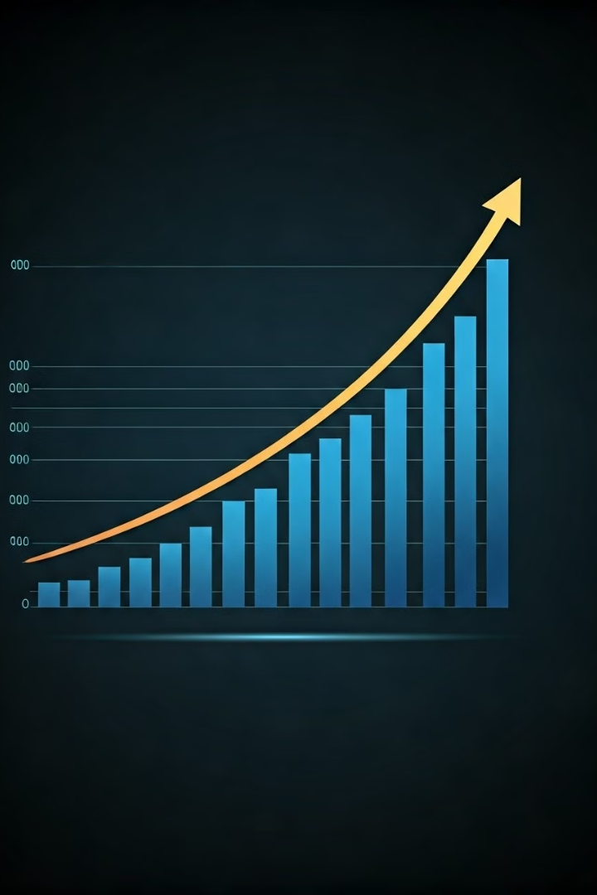
A Growing Market for Creators
Global Creator Economy
$104 Billion
NFT Sales in 2022
$20+ Billion
Fan Engagement Trend
Growing Rapidly

Slide 8
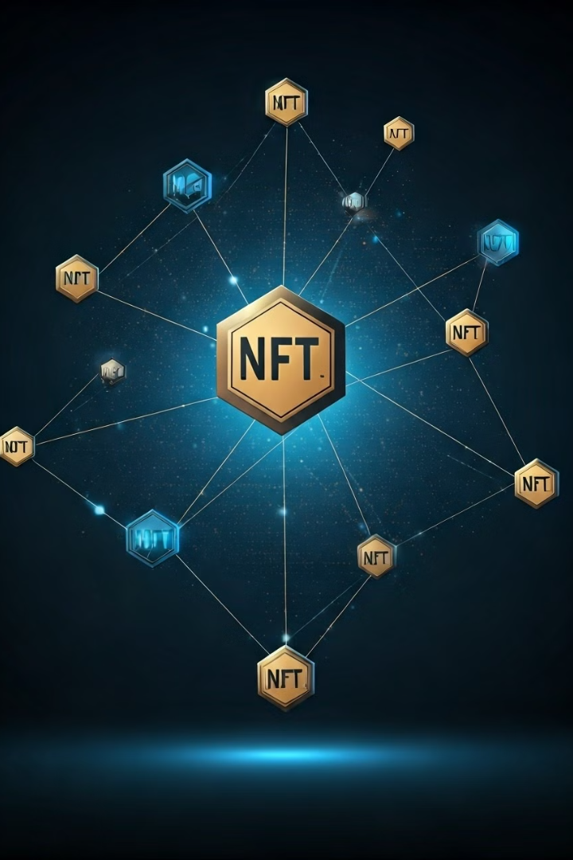




What Makes Solana Publish Stand Out?
Decentralized Control
Creators maintain full control over their work and distribution.
NFT-based Ownership
Each work is tokenized as an NFT for proof of ownership.
Smart Contract Royalties
Automatic royalty payments ensure ongoing earnings for creators.
DAO Governance
Community-driven decision-making process for the platform.

Slide 9
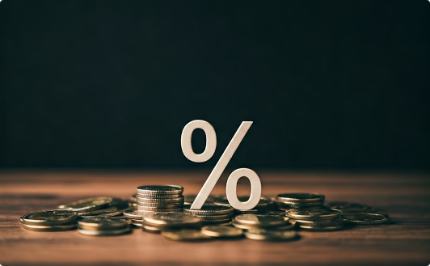
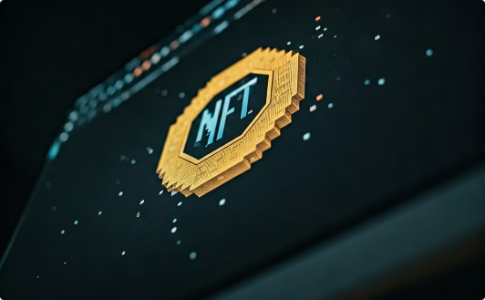
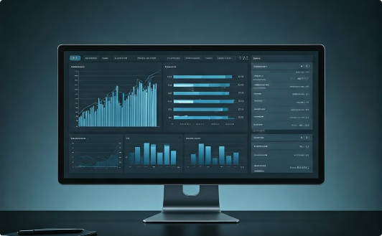
How We Make Money
Transaction Fees
NFT Minting Fees
Premium Subscriptions
Small percentage fee (1-2%) on every transaction.
Creators pay a small fee when minting their work as an NFT.
Offer creators premium tools and services for a monthly fee.

Slide 10

Join the Solana Publish Revolution
1
Empower Creators
2
Revolutionize Publishing
3
Connect Directly
Give voice to important social issues and marginalized authors.
Foster stronger connections between creators and their audience.
Leverage blockchain technology for a fair, efficient publishing ecosystem.

